Slide 1

Project Title
Minor Project - I
CS- 508
Problem Statement: Movies recommendations by using
machine learning.
Group Member Details: Sahil Saeed (0187CS211143)
Subhan Khan (0187CS223D04)
Syed Ayan Ali (0187CS201169)
Rehan Khan (0187CS)
Guide Details: Dr. Komal Thailiani

Slide 2
Idea/Approach Details
Abstract:
This website will be utilizing machine learning algorithms to analyze user behavior, movie features, and historical data to generate accurate recommendations.
The website contain a user-friendly interface to present recommendations .
Describe your idea Solution/Prototype here:
Developing a website to recommend movie using machine learning algorithms to analyze user preferences, historical data, and movie features to suggest relevant and enjoyable films.
The goal is to create a system that can analyze the preferences and behaviors of individual users, as well as characteristics of movies, to predict which movies a user is likely to enjoy.
Describe your Technology stack here:
Front-end: Html, CSS, Javascript and Bootstrap is used.
Back-end: Python is used.
Database : For storing Database Firebase is used.
Flask : Flask will be used to access web services.

Slide 3
Project Requirements
Functional Requirements
Non Functional Requirements
Recommendation Generation: Website uses algorithms to generate movie recommendations based on user preferences and past behavior.
Recommendation Presentation: Display movie recommendations to users in a user-friendly interface.
Scalability: Website would be designed to handle a large number of users and a growing dataset.
Performance: Optimized algorithms and database queries are used for efficient recommendation generation and retrieval.
Accuracy: The recommendation algorithm strive to provide accurate and relevant movie suggestions based on user preferences.
Robustness: Handle missing or incomplete data gracefully, without compromising the overall recommendation quality.
Maintenance: The system is easy to maintain and update, with mechanisms for incorporating new movie releases and user feedback.
Updatability: The system updates to the recommendation algorithm without disrupting the overall functionality of the system.

Slide 4
Project Requirements
Hardware and Software requirements (Developer)
Hardware Requirements:
Processor: Multi-core processor with sufficient speed for data processing and training.
Memory: At least 8 GB RAM for efficient handling of datasets and model training.
Storage: Adequate disk space for storing datasets, model checkpoints, and software libraries.
GPU (Optional): High-performance GPU for faster training of deep learning models.
Software Requirements:
Operating System: Compatible with Windows, macOS, or Linux distributions.
Machine Learning Libraries: Installation of libraries.
Data Source: Access to movie datasets such as IMDb, MovieLens, or Netflix Prize dataset for recommendation system.
Hardware and Software requirements (Client)
Hardware Requirements:
Personal Computer or Laptop: The client will need a personal computer or laptop.
Internet Connection: A stable internet connection is necessary to access the movie recommendation system.
Storage Space: Adequate storage space to store necessary files related to the movie recommendation system.
Software Requirements:
Operating System: The movie recommendation system should be compatible with the client's operating system.
Web Browser: The client will need a web browser to access the movie recommendation system.

Slide 5
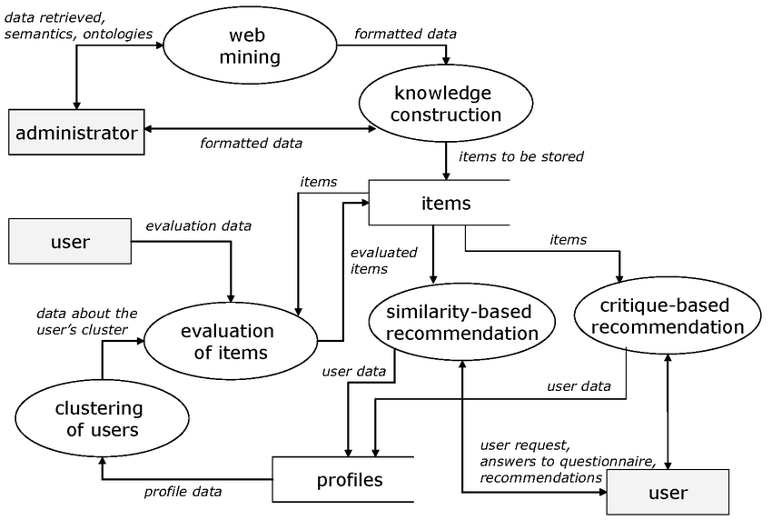
Design
Describe data flow diagram here(if applicable)

Slide 6
Design
Describe your Use Cases here
Personalized Recommendations: The system can analyze a user's viewing history, ratings, and preferences to provide personalized movie recommendations.
Similarity-based Recommendations: By analyzing the features of movies such as plot, cast, director, and user ratings, the system can recommend similar movies to those a user.
Trending Recommendations: The system can analyze current trends in movie popularity, box office performance, and social media buzz to recommend movies.
Cross-platform Recommendations: Integrating with streaming platforms, movie databases, and social media platforms, the system can offer recommendations across different platforms.
Describe your Dependencies / Show stopper here
Data Quality and Quantity: The effectiveness of a recommendation system heavily relies on the quality and quantity of data available.
Scalability: The recommendation system should be scalable to handle a growing user base and an expanding movie catalog.
User Interface (UI) Design: An intuitive and user-friendly interface is essential for user adoption.
Integration with Existing Systems: Integration with other systems or platforms (e.g., streaming services) is necessary for a seamless user experience.

Slide 7
Deployment Details
Describe Deployment Details here
Model Training: Train the recommendation model using machine learning algorithms such as collaborative filtering.
Database Setup: Set up a database to store movie metadata, user preferences, and other relevant information.
API Development: Developed an RESTAPI (Application Programming Interface) to serve movie recommendations to users.
Integration with Frontend: Integrate the recommendation API with the frontend interface of your application.
Scalability Considerations: Design the system to handle potentially large volumes of users and movie data.
By following these deployment details, we effectively deploy a machine learning-based movie recommendation system and provide personalized movie recommendations to users.

Slide 8
Monetary Support
Financial Requirements
Data Acquisition: Acquiring a comprehensive dataset of movies, including features like genre, cast, director, ratings, and user preferences.
Software and Tools: Utilizing machine learning frameworks like Pandas, along with programming languages like Python.
Maintenance and Updates: Ongoing maintenance to ensure the recommendation system remains accurate and up-to-date.
Marketing and User Acquisition: Promoting the recommendation system to attract users and generate interest.
Integration and Deployment: Integrating the recommendation system into existing platforms (e.g., streaming services, websites) and deploying it for production use. This involves additional development and testing efforts.

Slide 9
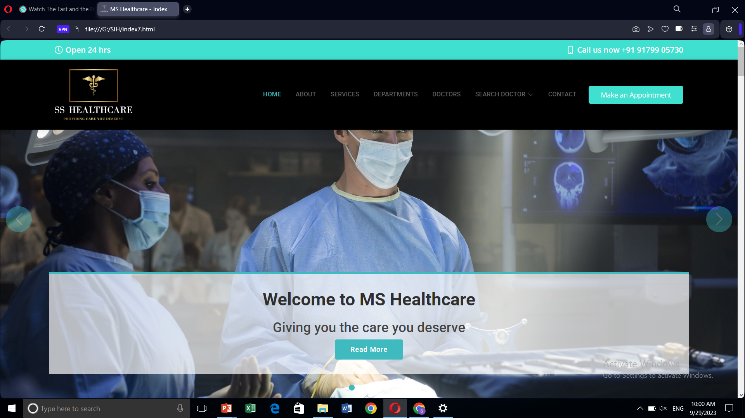
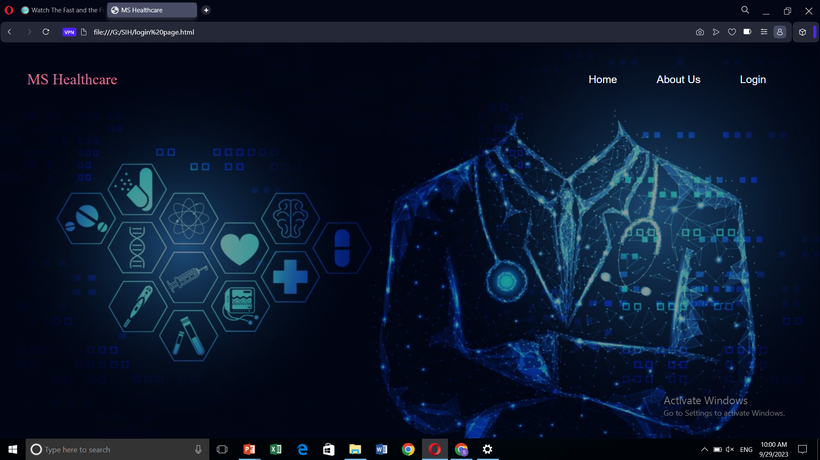
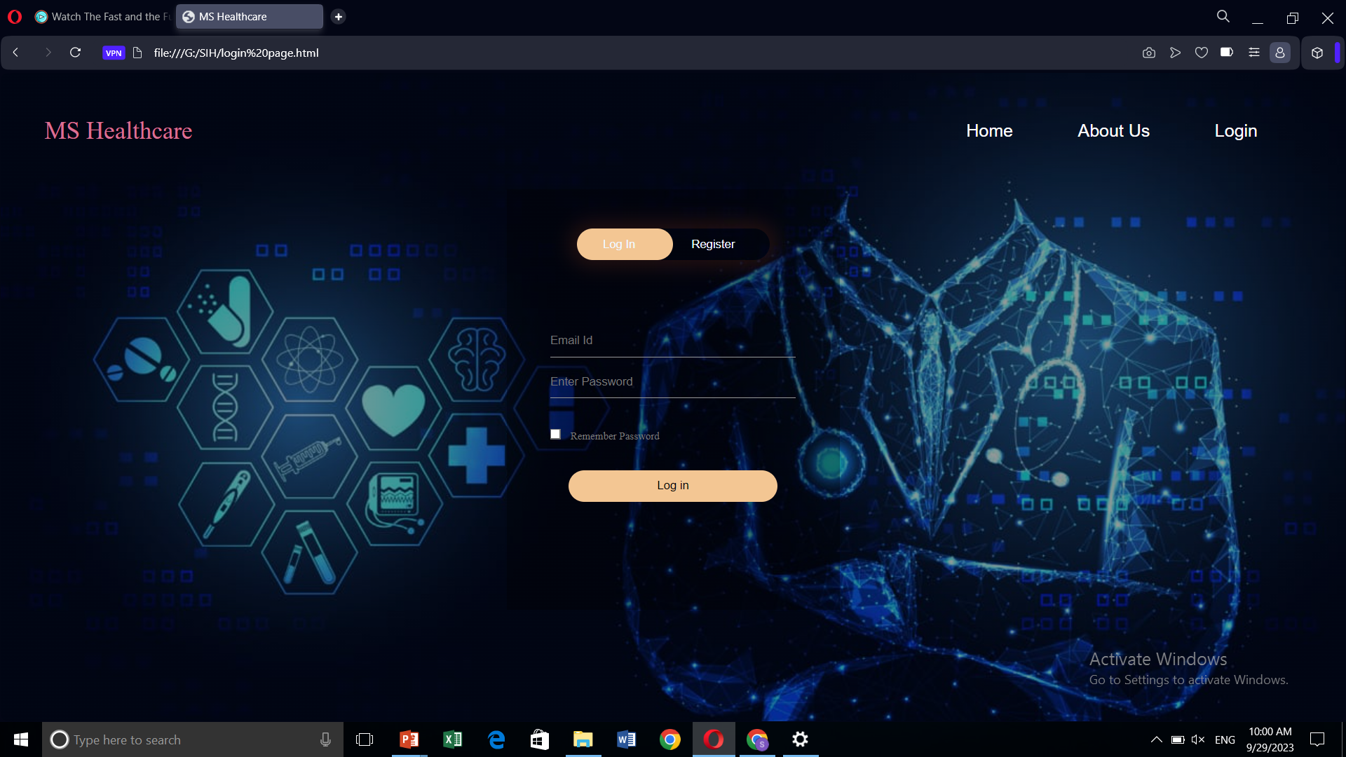
Project Screen shorts

Slide 10


